Slide 1

Artificial Intelligence
3 Solving Problems by Searching
Russell & Norvig, AI: A Modern Approach, 3rd Ed
(Informed Search)

Slide 2

Informed Search
Informed Search
Heuristics
Greedy Search
A* Search

Slide 3
Search Heuristics
Evaluation function, f(n)
The evaluation function is construed as a cost estimate, so the node with the lowest evaluation is expanded first.
A heuristic is:
A function that estimates how close a state is to a goal
Designed for a particular search problem
Examples: Manhattan distance, Euclidean distance for pathing

Slide 4
Greedy best-first search
Greedy best-first search
Tries to expand the node that is closest to the goal
On the grounds that this is likely to lead to a solution quickly.
Evaluates nodes by using just the heuristic function;
f(n) = h(n)

Slide 5
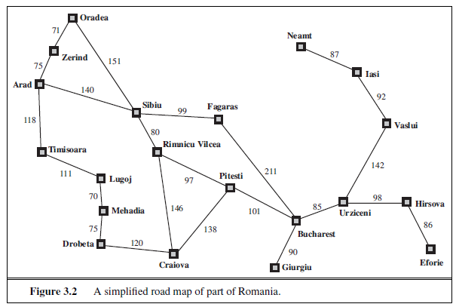
Greedy best-first search

Slide 6
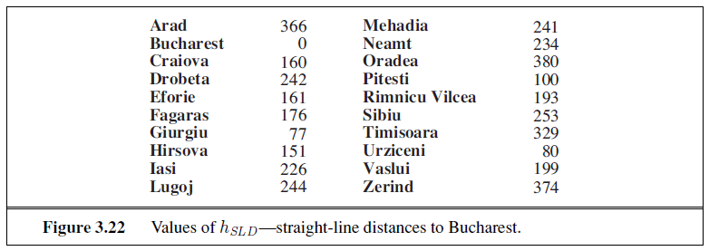
Greedy best-first search

Slide 7
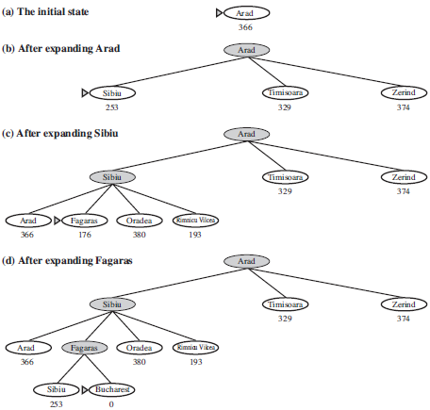
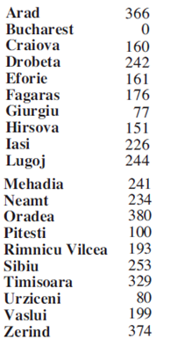
Greedy best-first search

Slide 8
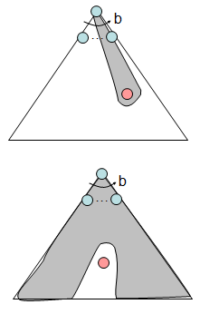
Greedy best-first search
Strategy: expand a node that you think is closest to a goal state
Heuristic: estimate of distance to nearest goal for each state
A common case:
Best-first takes you straight to the goal
Worst-case: like a badly-guided DFS

Slide 9
A* Search
Evaluates nodes by
combining g(n), the cost to reach the node, and
h(n), the cost to get from the node to the goal:
f(n) = g(n) + h(n) .

Slide 10
A* Search
Route Finding Problem Arad to Bucharest
Sorting Problem using swapping

Slide 11
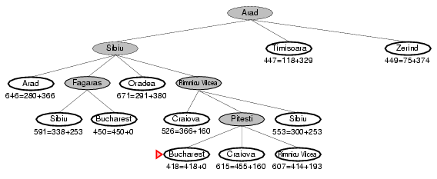
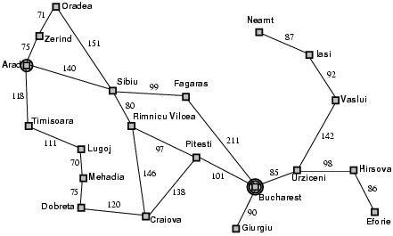
A* search example

Slide 12
Properties of Heuristics
Admissibility
Consistency
Dominance

Slide 13
Properties of Heuristics
Admissibility: h(n) never overestimates the actual cost for reaching a goal.
Consistency: h(n) <= cost(n,a)+h(a) for all pair of node (n,a).
Dominance: h1 dominates h2 iff h1(n)>=h2(n) for all node n.

Slide 14
Properties of Heuristics
Prove A* is Optimal
Prove A* is Complete
Need to prove “f-value will be non-decreasing along any path”.

Slide 15
Properties of A*
Complete?
Yes (unless there are infinitely many nodes)
Optimal?
Yes
Also optimally efficient:
No other optimal algorithm will expand fewer nodes, for a given heuristic
Time?
Exponential in worst case
Space?
Exponential in worst case

Slide 16
Memory Bounded Search
Iterative Deepening A* (IDA*)
Recursive Best-First Search (RBFS)
Memory Bounded A* / Simplified Memory Bounded A* (MA* / SMA*)

Slide 17
IDA* Example
0
G
8
20
12
A
8+ 0 =8
C
8
A
2
3
B
2+ 9 = 11
B
G
9
8+ 0 =8
12+ 0 =12
A
8+ 0 =8
A
C
A
B
G
4+ 8 =12
5+ 8 =13
First f-cutoff = 8
2+ 9 = 11
12+ 0 =12
Third f-cutoff = 12
Second f-cutoff = 11

Slide 18
IDA* Example Contd.
8+ 0 =8
A
2+ 9 = 11
12+ 0 =12
B
G
4+ 8 =12
Found Goal Node. No need expansion. Overall Expanded nodes sequence is: A B A G
A
C
5+ 8 =13
B
G
6+ 9 =15
16+ 0 =16

Slide 19
Recursive Best-First Search (RBFS)
Similar to DFS, but keeps track of the f-value of the best alternative path available from any ancestor of the current node
If current node exceeds f-limit -> backtrack to alternative path
As it backtracks, replace f-value of each node along the path with the best f(n) value of its children
This allows it to return to this subtree, if it turns out to look better than alternatives

Slide 20
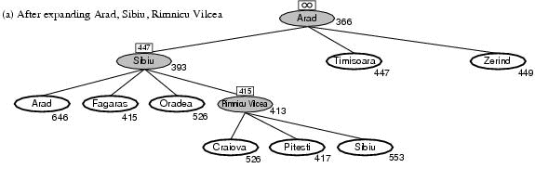
Recursive Best First Search: Example
Path until Rumnicu Vilcea is already expanded
Above node; f-limit for every recursive call is shown on top.
Below node: f(n)
The path is followed until Pitesti which has a f-value worse than the f-limit.

Slide 21
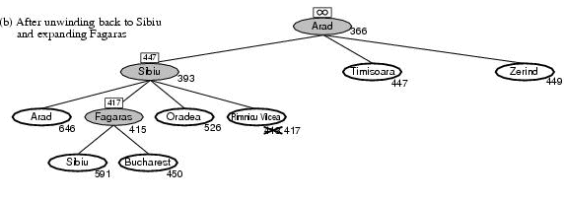
RBFS example
Unwind recursion and store best f-value for current best leaf Pitesti
best is now Fagaras. Call RBFS for new best
best value is now 450

Slide 22
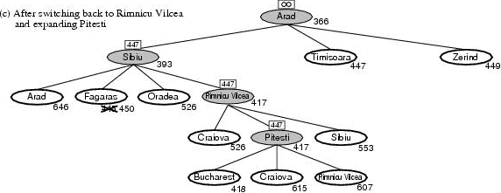
RBFS example
Unwind recursion and store best f-value for current best leaf Fagaras
best is now Rimnicu Viclea (again). Call RBFS for new best
Subtree is again expanded.
Best alternative subtree is now through Timisoara.
Solution is found since because 447 > 418.

Slide 23
RBFS properties
Complete (finite).
Like A*, optimal if h(n) is admissible
Time complexity difficult to characterize
Depends on accuracy if h(n) and how often best path changes.
Can end up “switching” back and forth
Space complexity is O(bd)
Other extreme to A* - uses too little memory.

Slide 24
(Simplified) Memory-bounded A* (SMA*)
This is like A*, but when memory is full we delete the worst node (largest f-value).
Like RBFS, we remember the best descendant in the branch we delete.
If there is a tie (equal f-values) we delete the oldest nodes first.
Simplified-ma* finds the optimal reachable solution given the memory constraint.
Time can still be exponential.

Slide 25
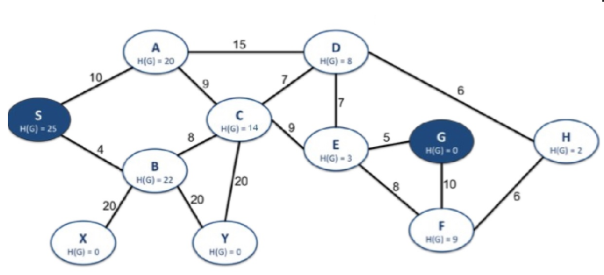
Simulation of Memory Bounded Search

Slide 26
Assignment:
4
2
B
3
E
8
2
4
3
4
A
G
D
0
4
1
2
4
2
C
6
F
2
5
A – Start
G – Goal
Black → Actual Cost
Red → heuristic cost
Solve the problem using following Algorithm:
A*
IDA*
RBFS

Slide 27
Thank you ☺

